Slide 1

Staff and Provider Training CAHPS & HOS
How to enhance the member experience

Slide 2
What is CAHPS
Consumer Assessment of Healthcare Providers and Systems (CAHPS) is the national standard for measuring and reporting on the experiences of members with their health plan.
  Member Survey- administered to a random selection (selected by CMS) of members who have been enrolled with the health plan for at least six months
  Conducted annually by an independent NCQA certified vendor
  Survey is available in English, Spanish, Chinese and Vietnamese
  Surveys are mailed to members and non-respondents are followed up by a phone call
Timeline
  March to June of each year

Slide 3
What is HOS
Health Outcomes Survey (HOS) collects member-reported health outcomes. The survey is used to measure how to care provided by the health plan affects the health outcomes of their members.
Member Survey- administered to a random sample of members.
Member are surveyed one year to collect a baseline, and then surveyed again two years later for follow-up to measure the changes in their physical and mental health over time.
Conducted annually by an independent NCQA certified Vendor
Survey is available in English, Spanish Chinese and Vietnamese
Surveys are mailed to members and non-respondents are followed up by a phone call
Timeline
  April to July of each year

Slide 4
Metrics: Overall Ratings
Rate Health Care
Rate Personal Doctor
Rate Health Plan
CAHPS
HOS
Doctor Patient Communication
Provider Explained things in a way easy to understand
Listened carefully to patient
Office staff courteous and respectful
Provider office helped manage care among different providers
Timely Care and Appointments
Easy to get care tests and appointments
Patient got routine appointments as soon as needed
Patient received urgent care as soon as needed
Physical Health
Improved or Maintained
Mental Health
Improved or Maintained
Physical Activity
Yes, your personal doctor advised you to start or increased physical activity
Fall Risk
Yes, discussed with your personal doctor
Urinary Incontinence
Yes, discussed with your personal doctor

Slide 5
How We Can All Help
Review medication and test results with your patient
Remind your patients to follow up with ordered tests
Make outreach call to noncompliant patients
Call or contact your patients to remind of the following;
When it is time for preventative care services such as annual wellness exams
Recommend cancer screening
Follow-up care for ongoing conditions such as hypertension and diabetes
Remind your patients about annual flu shots
Invite questions, be kind and courteous, offer the post visit survey and take action on areas of concern, share answers with MSO for further assistance or training if needed
Offer to schedule specialist and lab appointments

Slide 6
Requirement Reminders
Hospitals and specialists to send discharge summary and progress reports to the PCP timely
TAT for an urgent appointment is 2 days and the urgency is the members perception of the reason for the visit
TAT for routine visits with the PCP is 10 days and the specialist is 15 days
TAT for urgent referrals is 72 hours and for routine 14 calendar days for seniors *TAT is quickest if portal is used and the request is complete with all available clinical information
Give the member all possible information with realistic expectations
See sample questions on the next slide

Slide 7
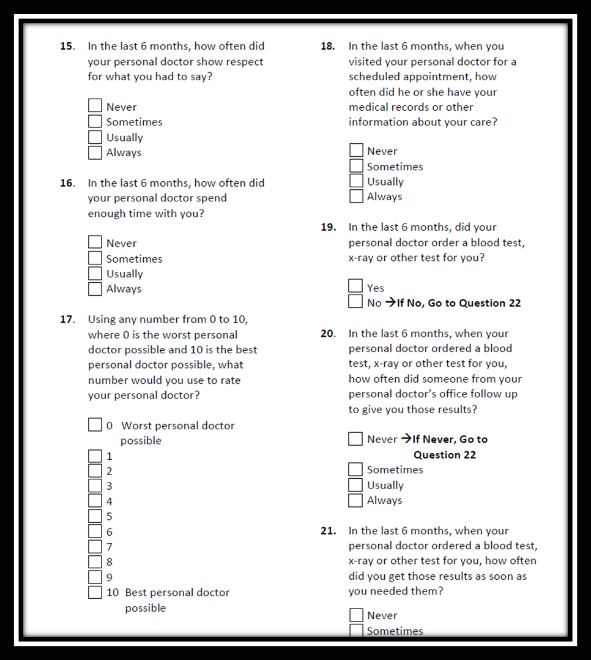

Slide 8
Thank you
For more information contact Noble AMA IPA at (877) 207-7600
  Autumn Mai, Noble AMA IPA Provider Relations x 102 or amai@pdtrust.com
  Cesar Delgado, Risk Adjustment Manager x 116 or cdelgado@pdtrust.com
  Katharine Nunez, Quality Manager x 103 or knunez@pdtrust.com
  Clinical Services, Option 2→Option 3→Option 3
  Mary Beltran, Administrator, x 132 or mabeltran@pdtrust.com
We appreciate your efforts as we aim for the STARs.

